Slide 1
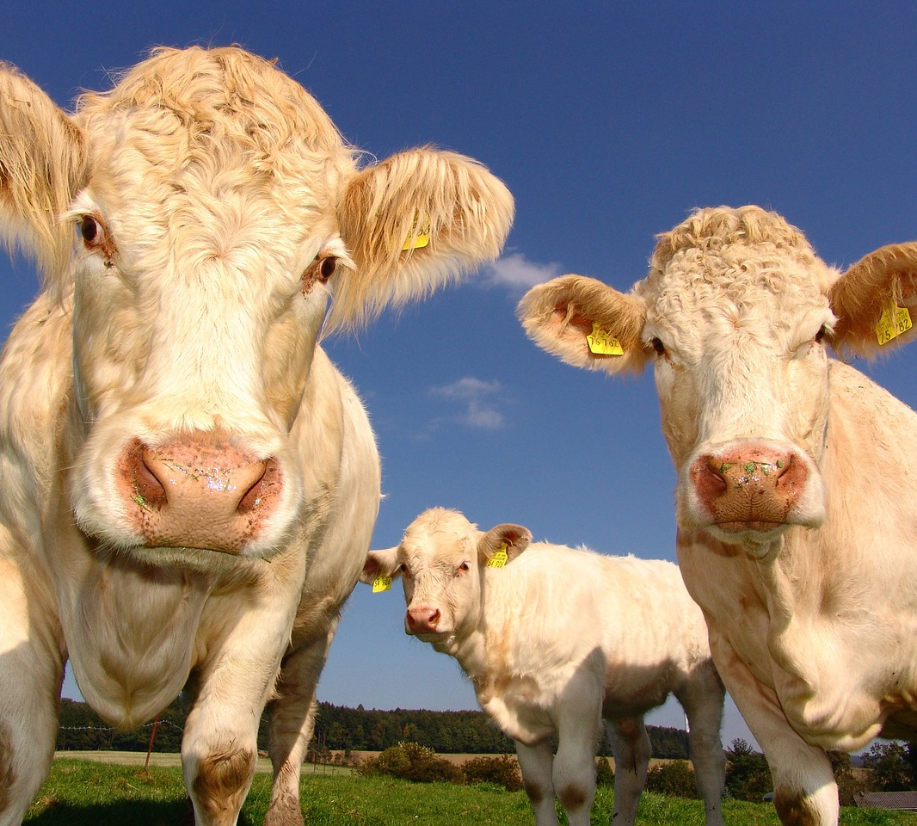
India Agriculture
By
M O H A M E D A L L A M

Slide 2
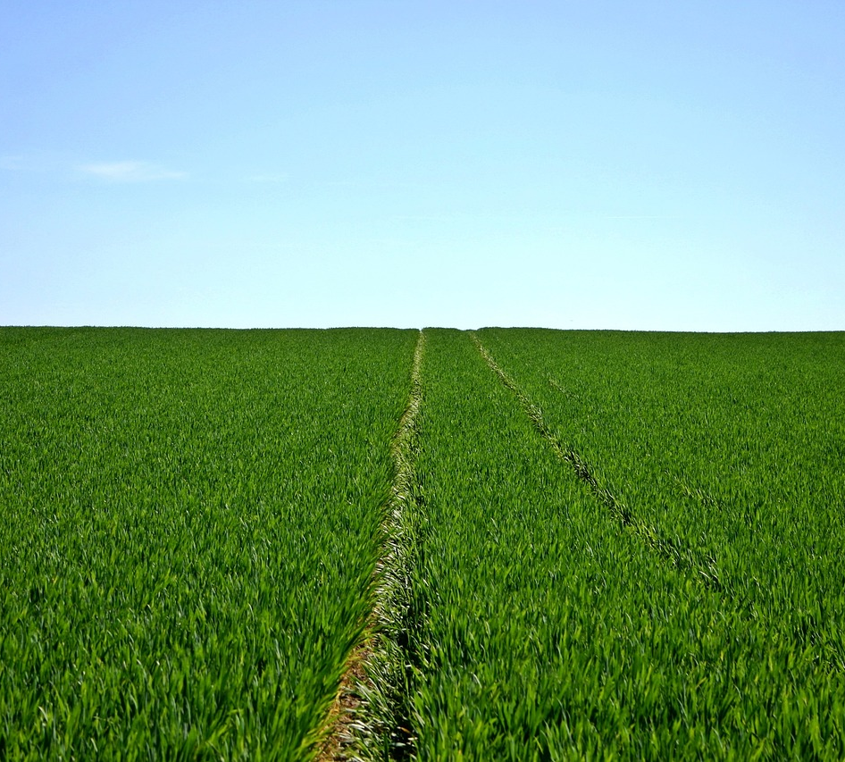
Agenda
Introduction
Import Data
Data Transformation
Data Modeling
Visualization

Slide 3

Introduction
The dataset contains district-level agricultural information for 20 key crops cultivated in India, covering aspects such as cultivation area, crop yield, and total production. This dataset facilitates in-depth examination of productivity patterns, encompassing both traditional crop strains and High Yielding Varieties (HYVs), which sheds light on contemporary farming techniques. Supported by thorough documentation, it ensures precision and transparency in analysis, serving as a valuable asset for policymakers, researchers, and stakeholders to comprehend regional agricultural trends and enhance targeted interventions. It serves as a robust resource for informed decision-making and strategic initiatives within India's agricultural domain.

Slide 4
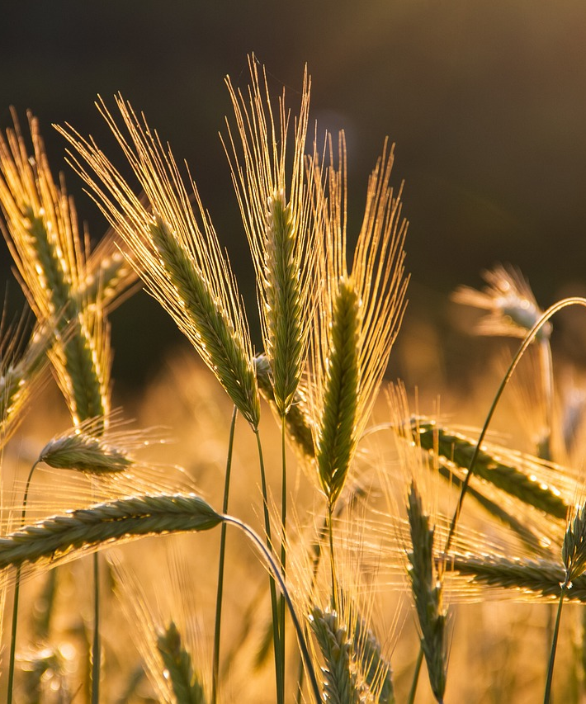
Import Data
Power bi

Slide 5
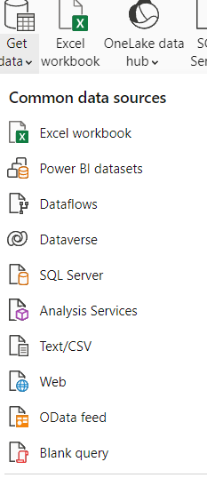
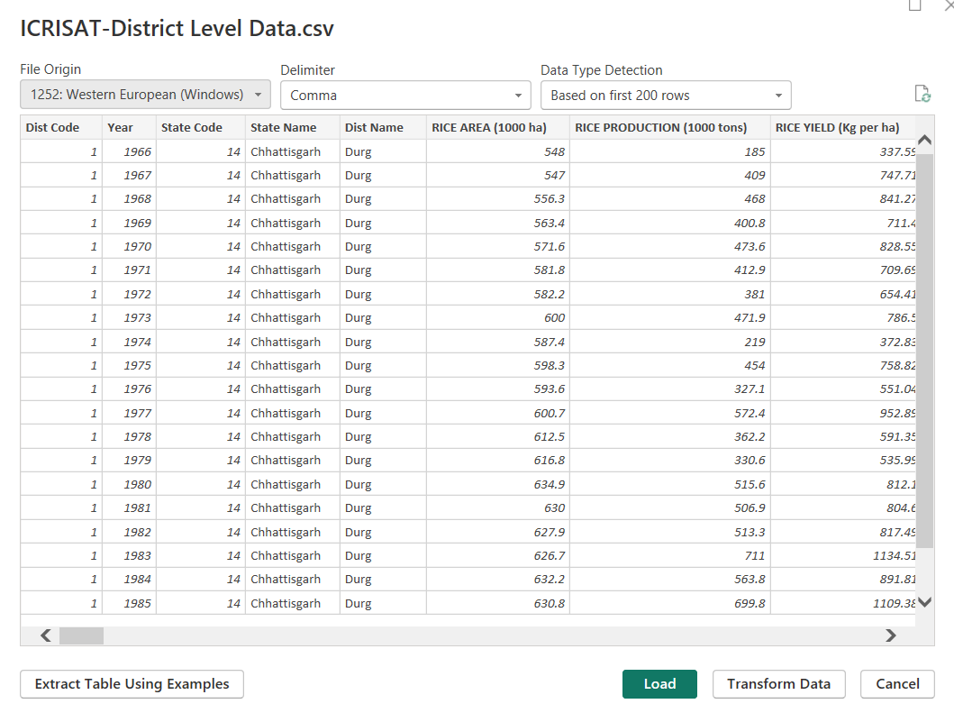

Slide 6
Data Transformation into Power Query

Slide 7
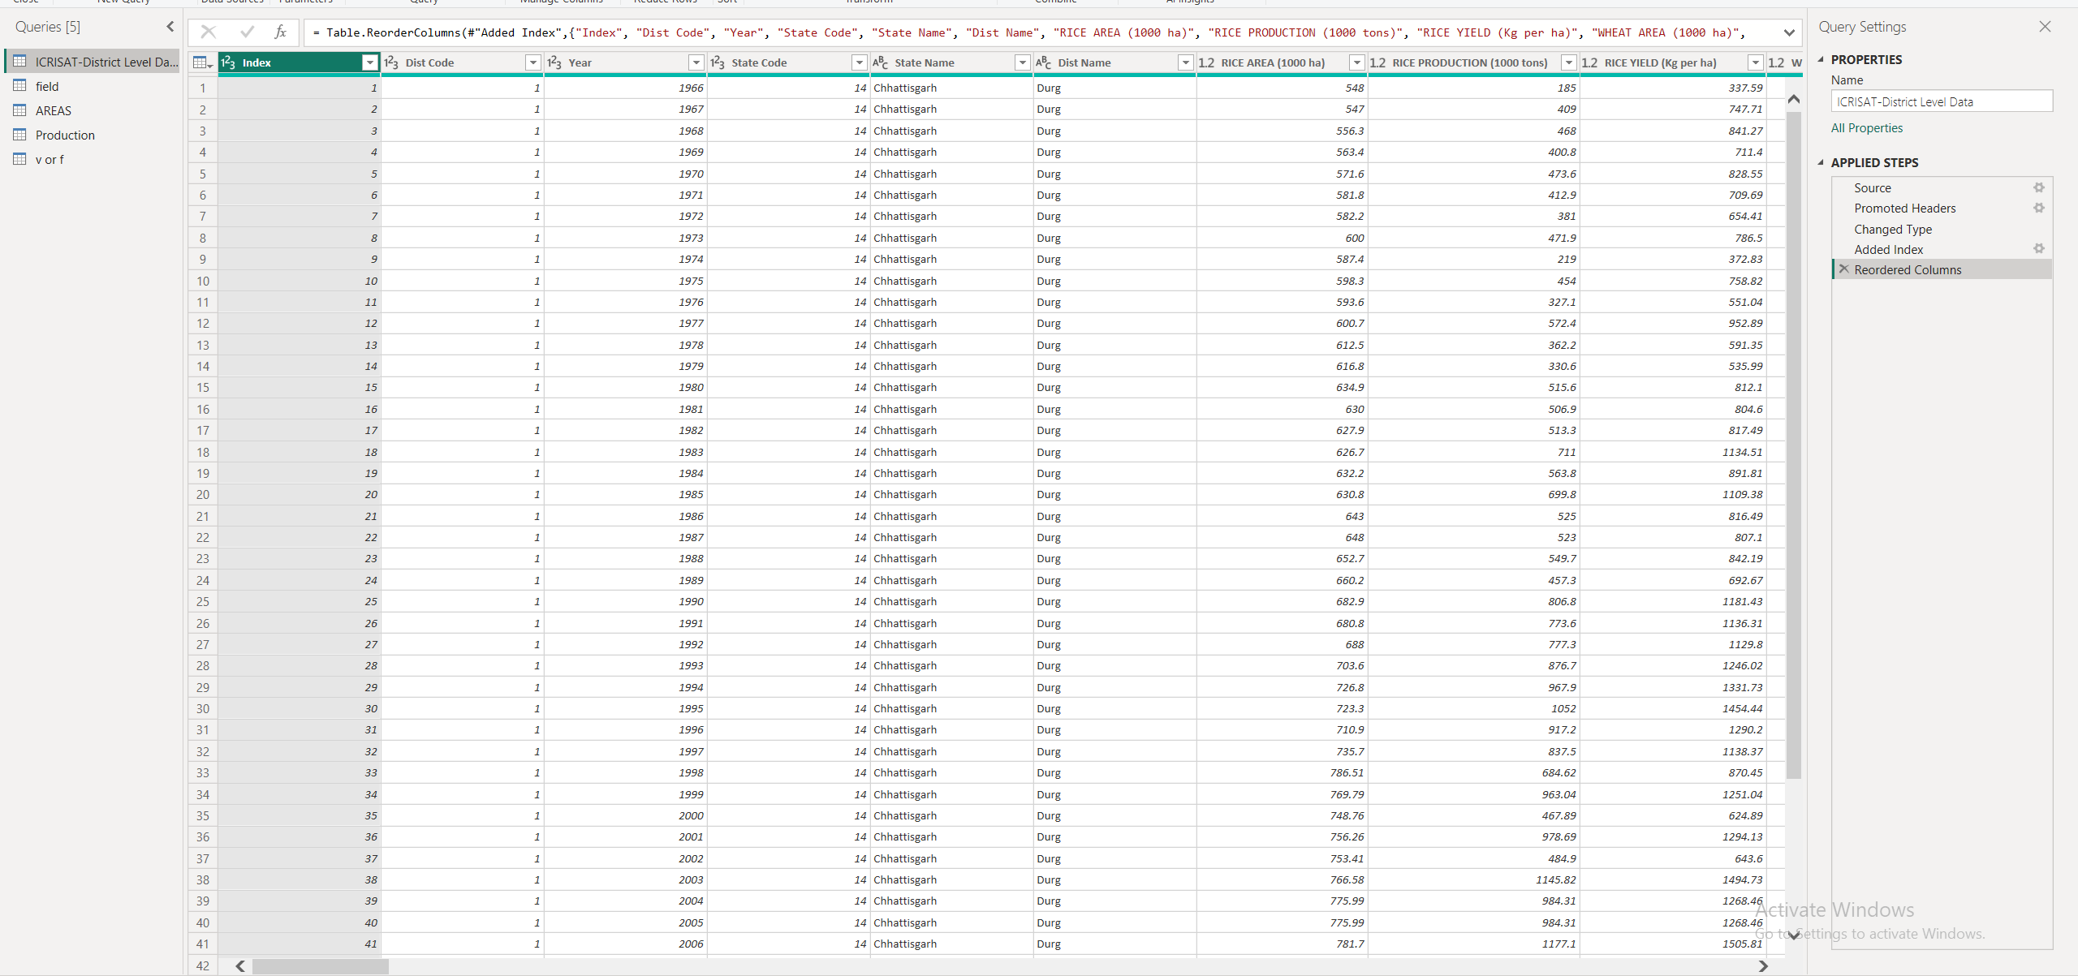

Slide 8

Data Modeling

Slide 9
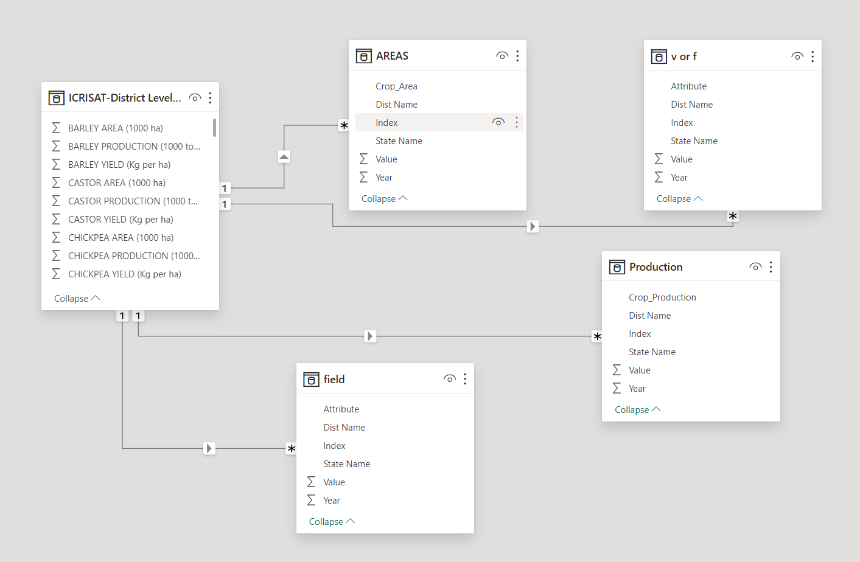

Slide 10
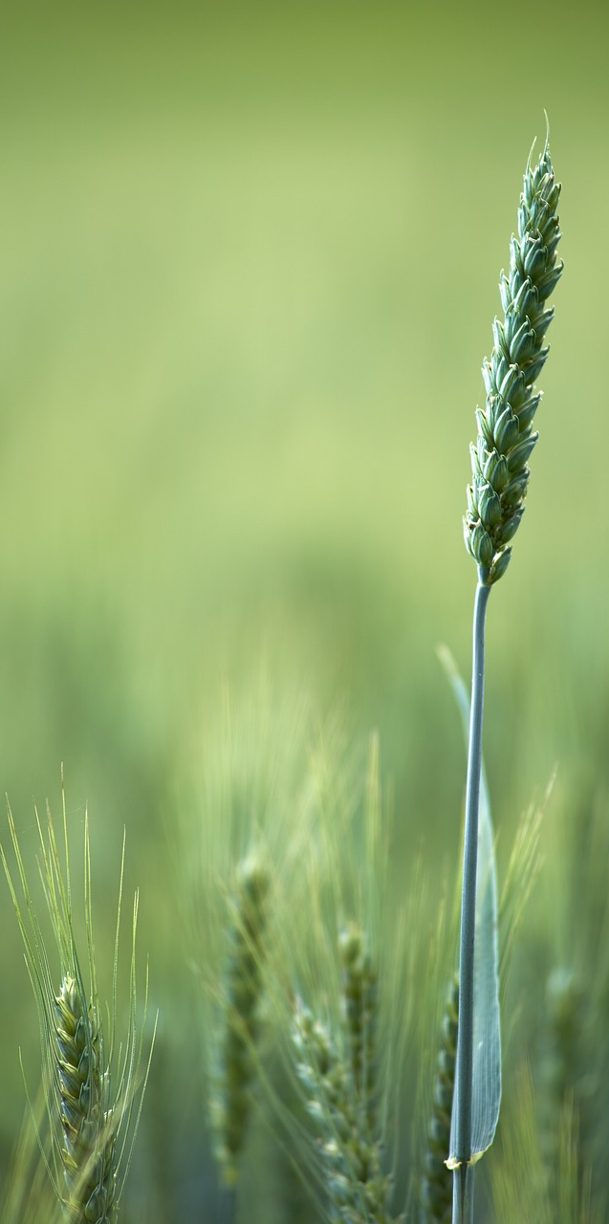
Data Visualisation

Slide 11
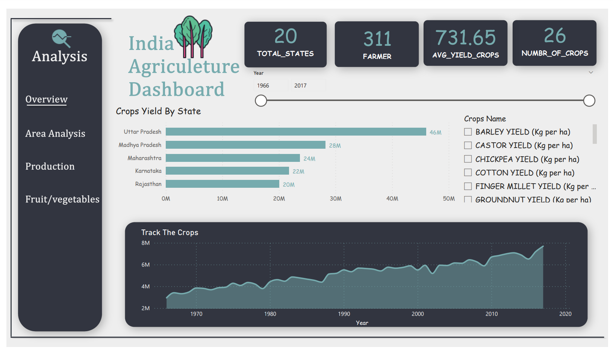
Overview

Slide 12
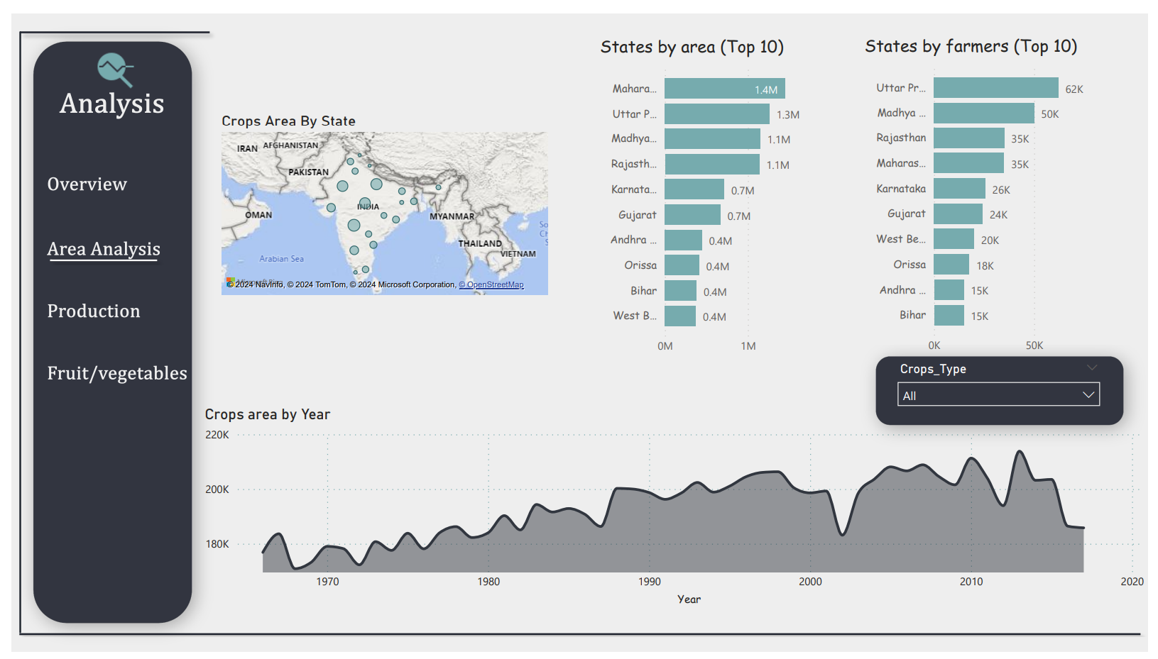
Area Analysis

Slide 13
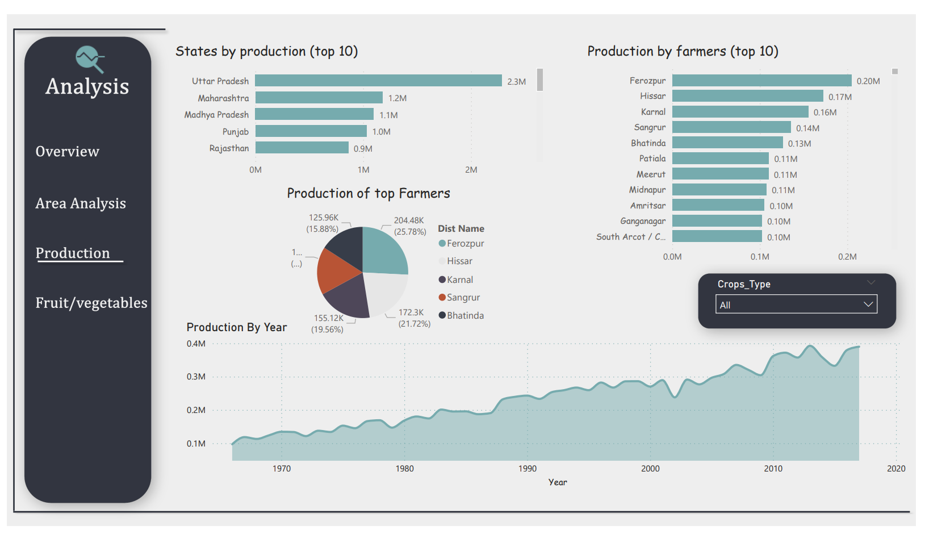
Production

Slide 14
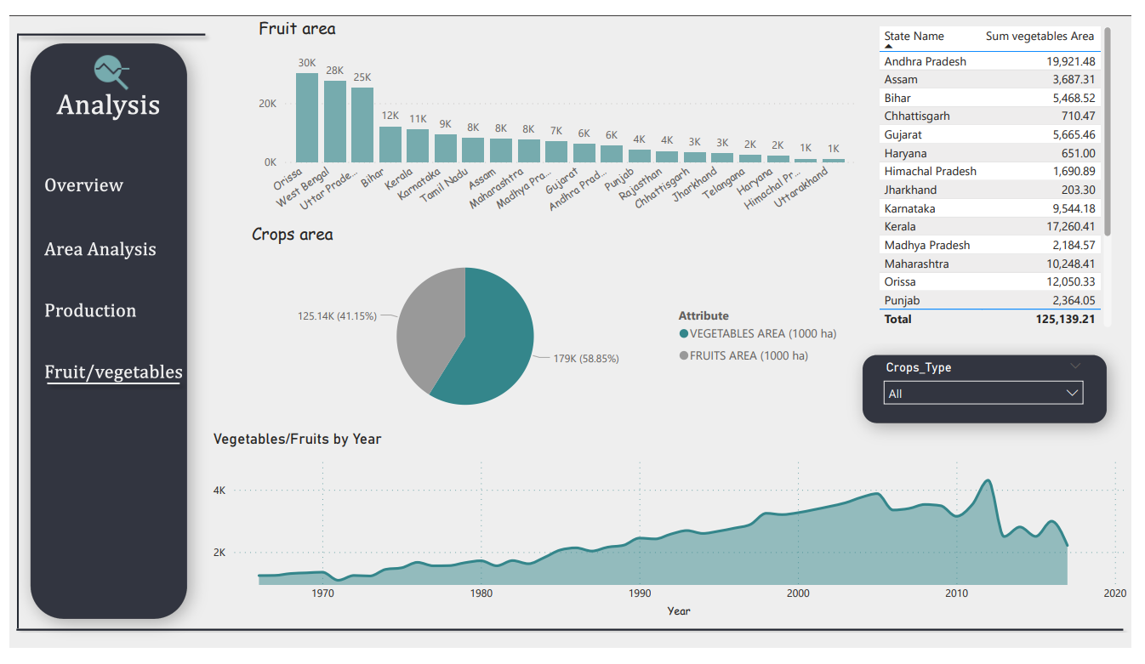
Fruit and Vegetables Analysis

Slide 15
By employing sophisticated data analysis methods, meaningful insights can be extracted from agricultural data, allowing for the improvement of crop yields, allocation of resources, and development of strategies to manage pests effectively. Through the utilization of data-driven methodologies, farmers are empowered to make educated choices aimed at enhancing productivity, sustainability, and resilience in their farming practices.
Summary

Slide 16
Thank you
Mohamed Allam
allammohamed3535@gmail.com

